Slide 1
Restaurant Automation Project Subject: Software Project
Submitted to: VND Sir
Date: 09/04/2019

Slide 2
Users of the web-based application:
Staff
Chef(Cook)
Admin(Owner)

Slide 3
Features of the Project in Brief
Restaurant Automation is a web-based application which automates the process of receiving the orders from the customers.
The orders are then shown to the chef and chefs can also mark the orders as "READY".
The bill for the order placed is generated automatically.

Slide 4
Functions of Staff:
View Menu
Login with their ID
Change Password
Take Order from Customer
Enter customer details
Place Order
View Bill/Invoice

Slide 5
Functions of Chef:
Login with their ID
Change Password
View Current Orders(Pending)
Mark order as "Ready"

Slide 6
Functions of Admin(Owner):
View Staff
Add/Remove Staff
View Chef
Add/Remove Chef
View Menu Items
Edit Menu Items

Slide 7
Concepts Used in Making of the Project
MySQL – Python Integration using ORM
Login Module(Authentication)
Administration using Django

Slide 8
DEMONSTRATION OF THE PROJECT:

Slide 9
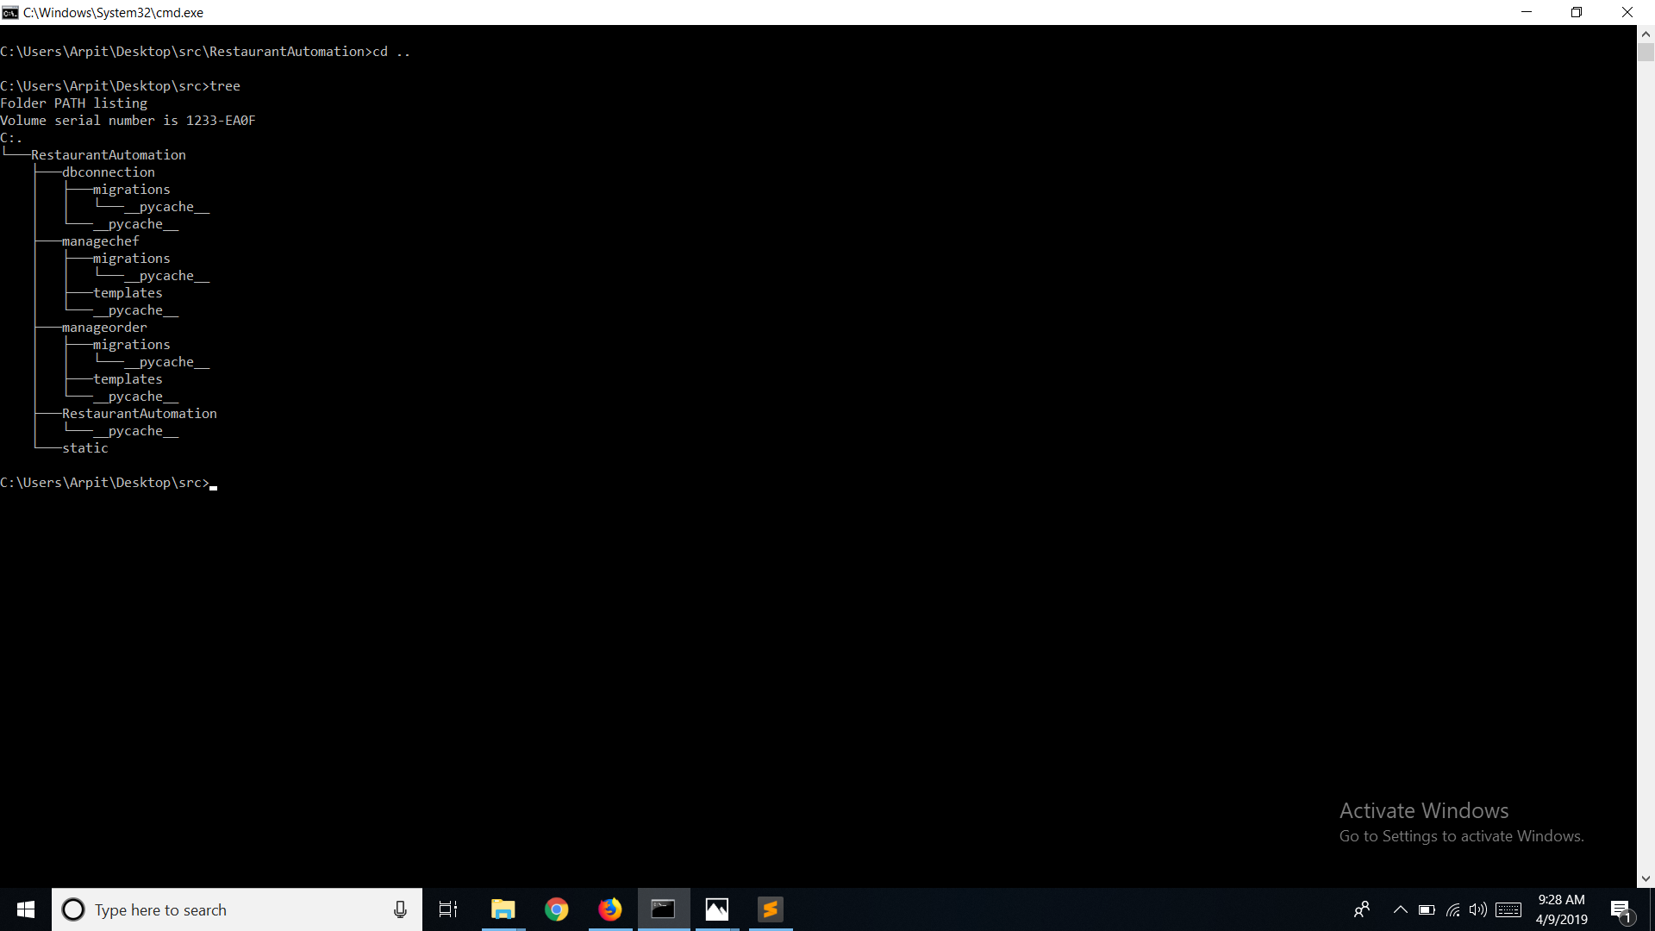
The Tree Structure of our project

Slide 10
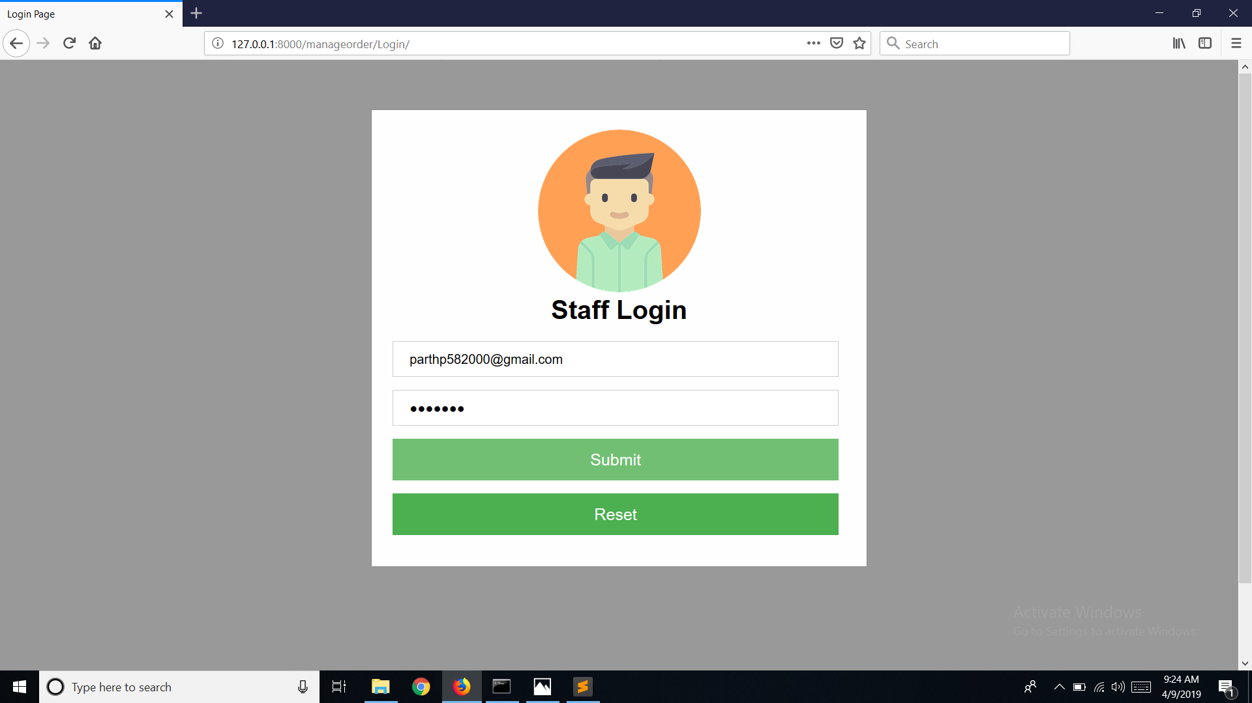
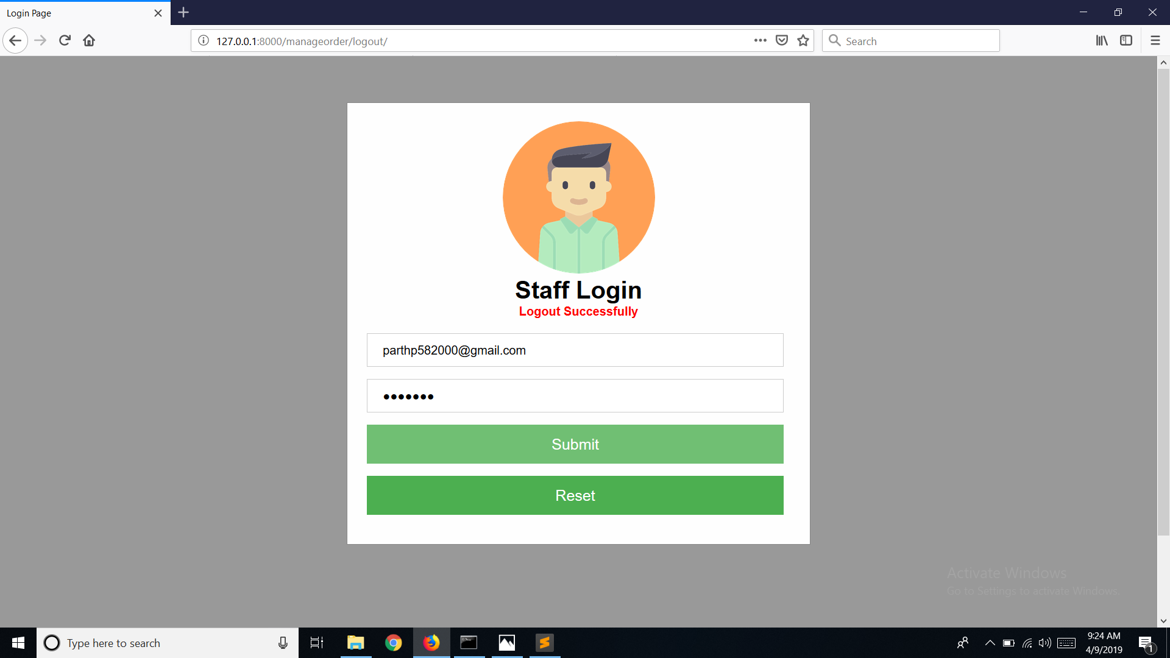
Login Page for the Staff Members

Slide 11
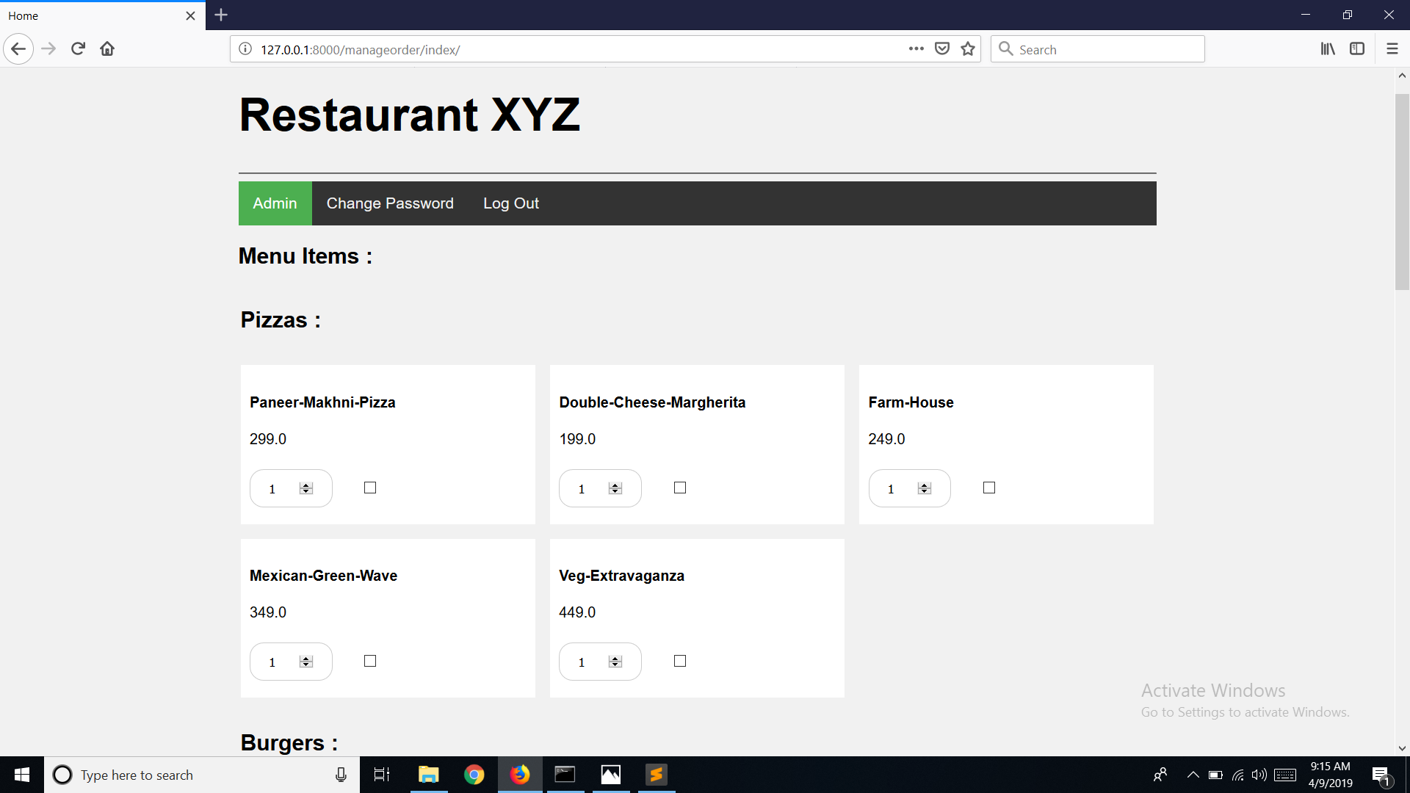
Home Page for the Staff Members

Slide 12
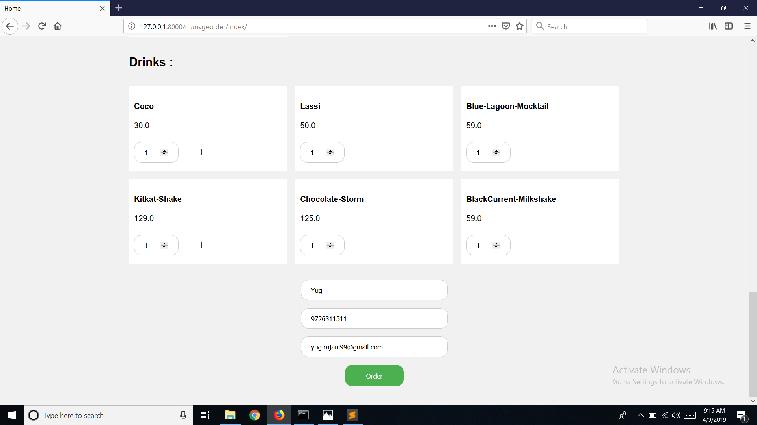
Collection of Customer Details Before Placing Order

Slide 13
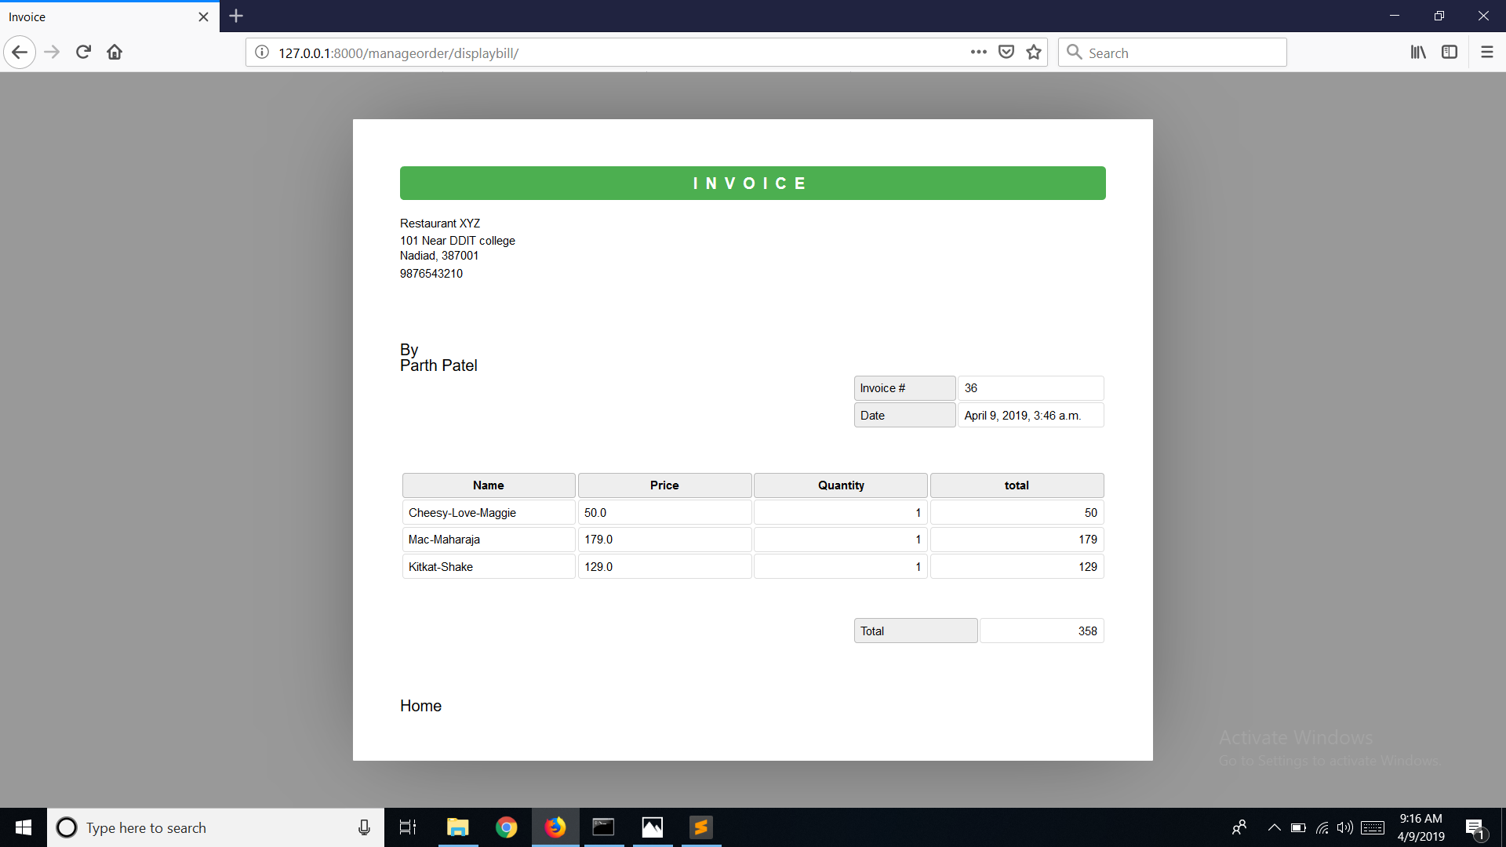
The Invoice/Bill of the order placed along with the name of staff

Slide 14
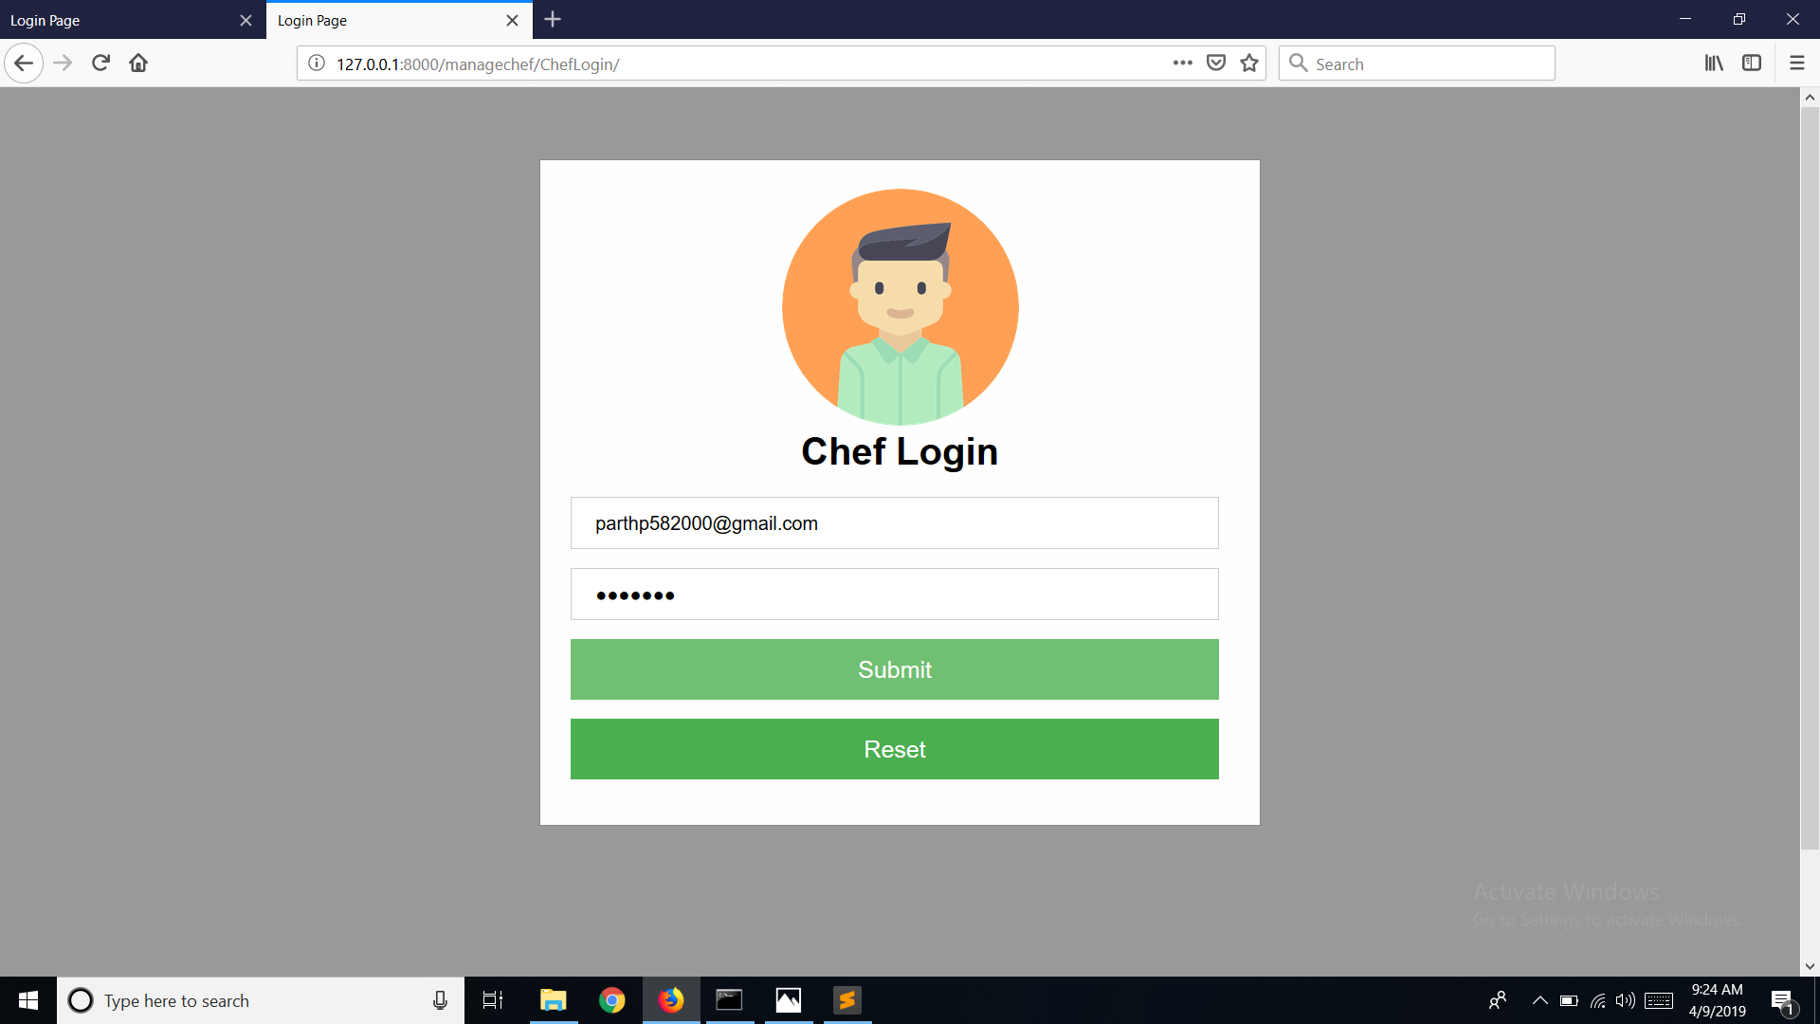
Login Page for the Chef(Cook) of the Restaurant

Slide 15
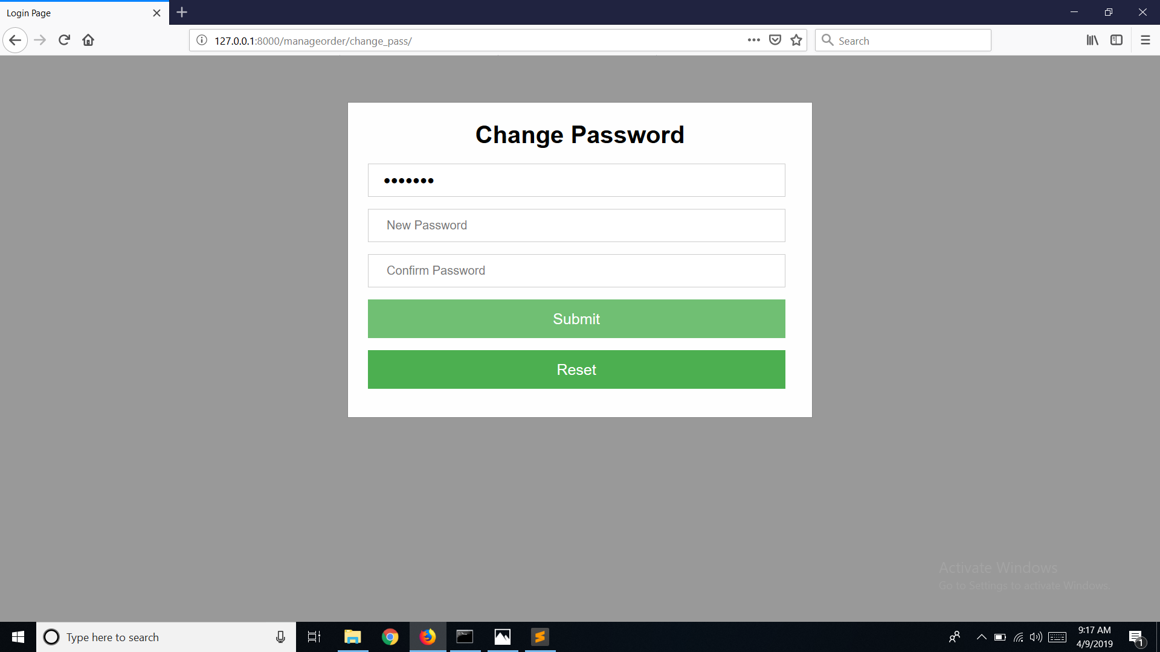
Chefs or Staff Members may change their passwords

Slide 16
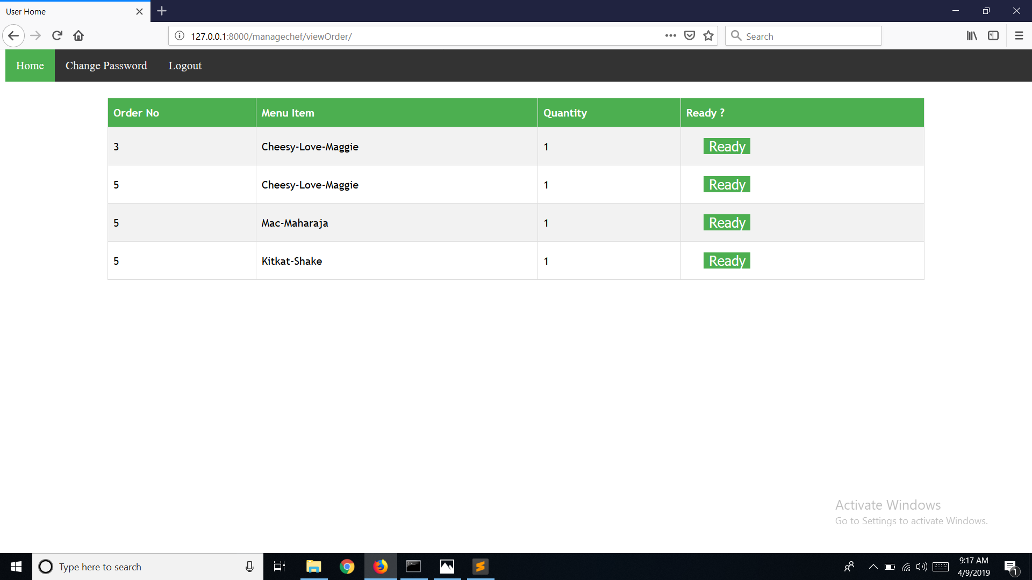
Chef can view the currently pending orders and mark them as "READY"

Slide 17
Logout page for the Staff Members and Chef

Slide 18
Thank You!
Made by:
Parth Patel (CE – 106)
Yug Rajani (CE – 124)
Zarmy Patel (CE – 110)

